Slide 1
OPINION SPAM DETECTOR:
Detecting Spam Reviews

Slide 2
ABSTRACT
Consumers increasingly rate, review and research products online. Consequently, websites containing consumer reviews are becoming targets of opinion spam. While recent work has focused primarily on manually identifiable instances of opinion spam, in this work we study deceptive opinion spam—fictitious opinions that have been deliberately written to sound authentic. Integrating work from behavioral features and text analysis, we develop and compare three approaches to detecting deceptive opinion spam, and ultimately develop a classifier from our spam dataset.

Slide 3
OBJECTIVE
General Objective
To detect opinion spam of reviewers using bag-of-words approach and to device a software that will detect spam reviews.
Specific Objectives
To be able to identify the authenticity of a certain review and separate it from spams
To be able to extract useful information through the use of Natural Language Processing methods.
To further improve the accuracy, and also look into spam in other kinds of media, e.g., forums and blogs.

Slide 4
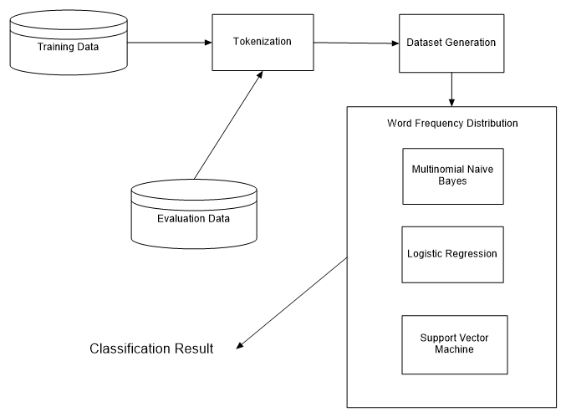
SYSTEM ARCHITECTURE

Slide 5
METHODOLOGY
Tokenization is the splitting of words to classify their functions in a sentence. Frequent Words Extraction counts the most frequent words used in the dataset and identify if they are frequently used in reviews or spams. Dataset Generation is the conversion of datasets from text files. Multinomial Naïve Baise Classifier, Support Vector Machine, and Logistic Regression are the classifications of datasets from the reviews. Evaluation Data evaluates data from the datasets and identifies reviews from spams. Data results outputs the results evaluated by the evaluation data.

Slide 6
RESULTS
Multinomial Naïve Bayes evalutation accuracy | 71.02%
Logistic Regression evaluation accuracy | 71.02%
Support Vector Machine evaluation accuracy | 67.34%

Slide 7
RECOMMENDATIONS
Possible directions for future work include an extended evaluation of the methods proposed in this work to both negative opinions, as well as opinions coming from other domains. Many additional approaches to detecting deceptive opinion spam are also possible, and a focus on approaches with high deceptive precision might be useful for production environments.

